Slide 1
Cookie, Session, MongoDB User Authentication
I4GIC

Slide 2
What is the scenario?
The scenario that we are going to work on is the general use case of normal authentication workflow:
User register their own account
User login
User verify email address with verify link/code (optional)
User get token for later api call
User make an api call with the token

Slide 3
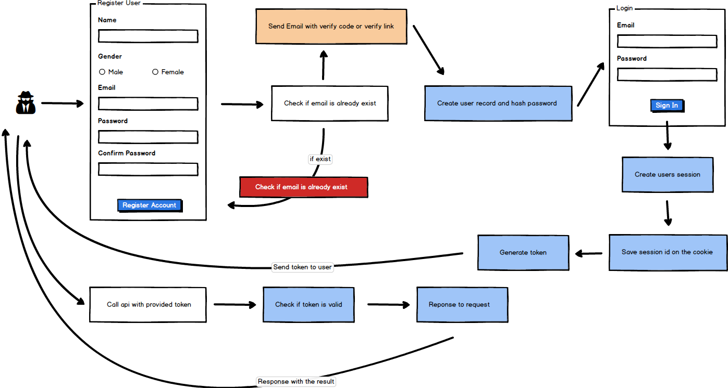

Slide 4
Key features
Cookie : are small pieces of information websites store on your computer. Cookies only contain bits of text, not anything else. The text can be a user ID, session ID, or any other text.
Good Uses for Cookies
Cookies store your login state. Without them, you wouldn’t be able to log into websites. Websites use cookies to remember and identify you.
Cookies store preferences on websites. You couldn’t change settings and have them persist between page loads without cookies.
Cookies allow websites to provide personalized content. For example, if you’re shopping on Amazon, Amazon can remember the products you’ve browsed and recommend similar products – even if you’re not logged in.

Slide 5
Key features
Bad Uses for Cookies
However, cookies can also be used for more questionable purposes. Advertising and tracking networks use tracking cookies to track you across the web.
When you visit website that uses scripts from an advertising network, that network can set a cookie in your browser. When you visit another website that uses tracking scripts from the same network, the advertising network can check the value of your cookie – it knows the same person visited both websites. In this way, the advertising networks track you across the web.

Slide 6
Key features
Session: Because HTTP is stateless, in order to associate a request to any other request, you need a way to store user data between HTTP requests.
Cookies or URL parameters are both suitable ways to transport data between 2 or more request. However they are not good in case you don't want that data to be readable/editable on client side.
The solution is to store that data server side, give it an "id", and let the client only know (and pass back at every http request) that id. There you go, sessions implemented.

Slide 7
Key features
Token: is a string of data that represents something else, such as an identity. Token is encrypted with/without a secret key.
If you encode the token with a secret key that only you know, you can decode it back and tell if the token was valid.
Token is used to secure API in our case. We want to make sure that only allowed people can call the API.

